Slide 1

APEX INSTITUTE OF TECHNOLOGY
DEPARTMENT OF COMPUTER SCIENCE & ENGINEERING
Artificial Intelligence (20CSD-385)
Faculty: Ankur Sharma(E13693)
Lecture – 1.2
Searching Techniques
DISCOVER . LEARN . EMPOWER

Slide 2
Artificial Intelligence : Course Objectives
COURSE OBJECTIVES
(AI) is a research field that studies how to realize the intelligent human behaviors on a computer. The ultimate goal of AI is to make a computer that can learn, plan, and solve problems autonomously. Although AI has been studied for more than half a century, we still cannot make a computer that is as intelligent as a human in all aspects, The main research topics in AI include: problem solving, reasoning, planning, natural language understanding, computer vision, automatic programming, machine learning, and so on. Of course, these topics are closely related with each other. In this course, we will study the most fundamental knowledge for understanding AI. We will introduce some basic search algorithms for problem solving; knowledge representation and reasoning; pattern recognition; fuzzy logic; and neural networks

Slide 3
COURSE OUTCOMES
On completion of this course, the students shall be able to:-
CO1 | Understand the basics of the theory and practice of Artificial Intelligence as a discipline and about intelligent agents capable of problem formulation
CO2 | Apply different uninformed search algorithms on well formulate problems along with stating valid conclusions that the evaluation supports.

Slide 4
Unit-1 Syllabus
Unit-1
Ch1.Introduction to AI | Introduction Artificial Intelligence and its applications, Artificial Intelligence Techniques, Intelligent Agents, Nature of Agents, Learning Agents., advantages, and limitations of AI, Application of AI.
Ch2.Searching techniques | Problem solving techniques State space search, control strategies, Blind search
Ch3.Informed search | Heuristic search, problem characteristics, production system characteristics., Generate and test, Hill climbing, best first search, A* search, Constraint satisfaction problem.

Slide 5
SUGGESTIVE READINGS
TEXT BOOKS
T1. Artificial Intelligence: A Modern Approach by Stuart Russell and Peter Norvig. Prentice-Hall, 2003 (2ndEdition). T2. Elaine Riche, Kevin Knight and Shivashankar B. Nair, “Artificial Intelligence”, Third Edition, TMH Educations Pvt. Ltd., 2008
REFERENCE BOOKS
R1 Nils J. Nilsson, “The Quest for Artificial Intelligence”, Second Edition, Cambridge University Press, 2009
R2 Artificial Intelligence and Expert Systems – Dan W. Patterson, Prentice Hall of India

Slide 6
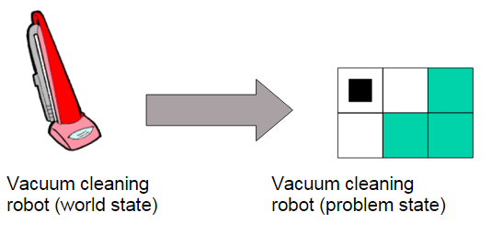
Problem-solving agents
Problem-solving agents is a special kind of goal-based agent.
• Tasks: – How to define a problem? – Problem type of formulation depends on available knowledge. – Problems, solutions, what is this? • Six different search strategies
All problem-solving agents are abstract – World state: specification of every aspect of reality – Problem state: only problem-relevant aspects

Slide 7
Problem-solving agent
The problem-solving agent preforms precisely by defining problems and its several solutions.
According to psychology, “a problem-solving refers to a state where we wish to reach to a definite goal from a present state or condition.”
According to computer science, a problem-solving is a part of artificial intelligence which encompasses a number of techniques such as algorithms, heuristics to solve a problem.
Therefore, a problem-solving agent is a goal-driven agent and focuses on satisfying the goal.

Slide 8
Steps performed by Problem-solving agent
Goal Formulation: It is the first and simplest step in problem-solving. It organizes the steps/sequence required to formulate one goal out of multiple goals as well as actions to achieve that goal. Goal formulation is based on the current situation and the agent's performance measure (discussed below).
Problem Formulation: It is the most important step of problem-solving which decides what actions should be taken to achieve the formulated goal. There are following five components involved in problem formulation:
Initial State: It is the starting state or initial step of the agent towards its goal.
Actions: It is the description of the possible actions available to the agent.
Transition Model: It describes what each action does.
Goal Test: It determines if the given state is a goal state.
Path cost: It assigns a numeric cost to each path that follows the goal. The problem-solving agent selects a cost function, which reflects its performance measure. Remember, an optimal solution has the lowest path cost among all the solutions.

Slide 9
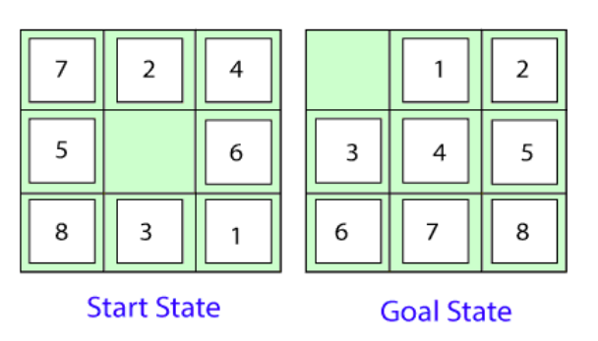
There are two types of problem approaches:
Toy Problem: It is a concise and exact description of the problem which is used by the researchers to compare the performance of algorithms.
Real-world Problem: It is real-world based problems which require solutions. Unlike a toy problem, it does not depend on descriptions, but we can have a general formulation of the problem
The problem formulation is as follows:
States: It describes the location of each numbered tiles and the blank tile.
Initial State: We can start from any state as the initial state.
Actions: Here, actions of the blank space is defined, i.e., either left, right, up or down
Transition Model: It returns the resulting state as per the given state and actions.
Goal test: It identifies whether we have reached the correct goal-state.
Path cost: The path cost is the number of steps in the path where the cost of each step is 1.

Slide 10
Understand how searching can be used by the agent to solve a problem.
Measuring problem-solving performance
Before discussing different search strategies, the performance measure of an algorithm should be measured. Consequently, There are four ways to measure the performance of an algorithm:
Completeness: It measures if the algorithm guarantees to find a solution (if any solution exist).
Optimality: It measures if the strategy searches for an optimal solution.
Time Complexity: The time taken by the algorithm to find a solution.
Space Complexity: Amount of memory required to perform a search.
The complexity of an algorithm depends on branching factor or maximum number of successors, depth of the shallowest goal node (i.e., number of steps from root to the path) and the maximum length of any path in a state space.
For solving different kinds of problem, an agent makes use of different strategies to reach the goal by searching the best possible algorithms. This process of searching is known as search strategy.

Slide 11
Search Strategies
Uninformed Search (Blind Search)
There are following types of uninformed searches:
Breadth-first search
Uniform cost search
Depth-first search
Depth-limited search
Iterative deepening search
Bidirectional search
Informed Search (Heuristic Search)
Best first search (Greedy search)
A* search

Slide 12
Uninformed Search (Blind Search)
Search strategy does not have any additional information about the states except the information provided in the problem definition. They can only generate the successors and distinguish a goal state from a non-goal state. These type of search does not maintain any internal state, that’s why it is also known as Blind search
Breadth-first search
Uniform cost search
Depth-first search
Depth-limited search
Iterative deepening search
Bidirectional search

Slide 13
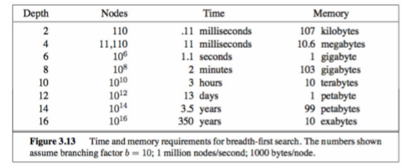
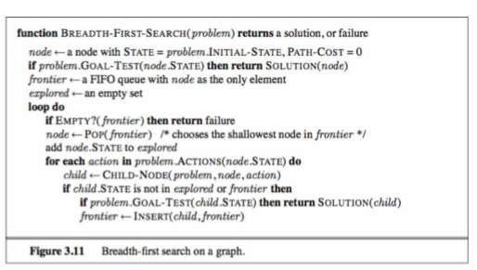
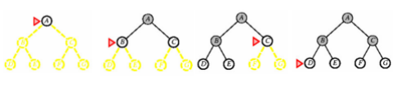
Breadth-first search

Slide 14
BFS Algorithm
Set a variable NODE to the initial state, i.e., the root node.
Set a variable GOAL which contains the value of the goal state.
Loop each node by traversing level by level until the goal state is not found.
While performing the looping, start removing the elements from the queue in FIFO order.
If the goal state is found, return goal state otherwise continue the search.
The performance measure of BFS is as follows:
Completeness: It is a complete strategy as it definitely finds the goal state.
Optimality: It gives an optimal solution if the cost of each node is same.
Space Complexity: The space complexity of BFS is O(b^{d}), i.e., it requires a huge amount of memory. Here, b is the branching factor and d denotes the depth/level of the tree
Time Complexity: BFS consumes much time to reach the goal node for large instances.
Disadvantages of BFS
The biggest disadvantage of BFS is that it requires a lot of memory space, therefore it is a memory bounded strategy.
BFS is time taking search strategy because it expands the nodes breadthwise.

Slide 15
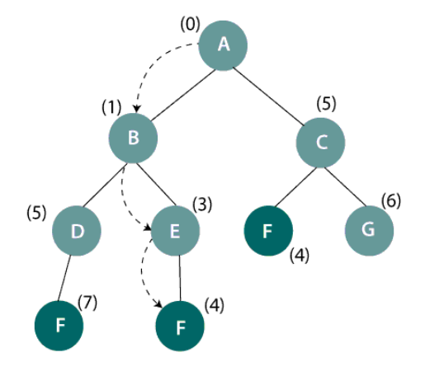
Uniform-cost search
The uninformed search explores nodes based on their path cost from the root node. It expands a node n having the lowest path cost g(n), where g(n) is the total cost from a root node to node n. Uniform-cost search is significantly different from the breadth-first search because of the following two reasons:
First, the goal test is applied to a node only when it is selected for expansion not when it is first generated because the first goal node which is generated may be on a suboptimal path.
Secondly, a goal test is added to a node, only when a better/ optimal path is found.
Thus, uniform-cost search expands nodes in a sequence of their optimal path cost because before exploring any node, it searches the optimal path. Also, the step cost is positive so, paths never get shorter when a new node is added in the search

Slide 16
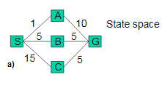
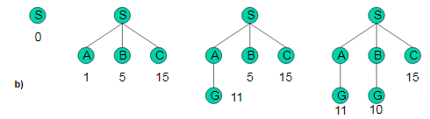
Uniform-cost search
• Modified breadth-first, expands only the node with the least cost (using path g(n)).
• Breadth-first = uniform-cost search with g(n)=depth(n).
Problem: from S to G, costs are marked (a). SAG is first solution (cost 11). The algorithm does not recognize this as solution, because 11 > 5 from B). SBG as final solution (b).

Slide 17
Uniform-cost search
Finds optimal solution when one assumption holds: path cost is a nondecreasing function of the depth of the node (while traversing through the tree)
• When costs are identical ! breadth-first
• Uniform-cost search is guided by path costs rather than depths, so its complexity cannot easily be characterized in terms of b and d
• Instead, let C* be the cost of the optimal solution, and assume that every action costs at least ε . Then the algorithm’s worst- case time and space complexity is O(b 1+ ⎣ C*/ε ⎦ ) , which can be much greater than b d

Slide 18
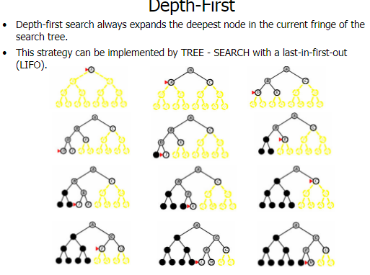

Slide 19
Depth-first search
This search strategy explores the deepest node first, then backtracks to explore other nodes. It uses LIFO (Last in First Out) order, which is based on the stack, in order to expand the unexpanded nodes in the search tree. The search proceeds to the deepest level of the tree where it has no successors. This search expands nodes till infinity, i.e., the depth of the tree.

Slide 20
DFS search tree
In the above figure, DFS works starting from the initial node A (root node) and traversing in one direction deeply till node I and then backtrack to B and so on. Therefore, the sequence will be A->B->D->I->E->C->F->G.
DFS Algorithm
Set a variable NODE to the initial state, i.e., the root node.
Set a variable GOAL which contains the value of the goal state.
Loop each node by traversing deeply in one direction/path in search of the goal node.
While performing the looping, start removing the elements from the stack in LIFO order.
If the goal state is found, return goal state otherwise backtrack to expand nodes in other direction.
The performance measure of DFS
Completeness: DFS does not guarantee to reach the goal state.
Optimality: It does not give an optimal solution as it expands nodes in one direction deeply.
Space complexity: It needs to store only a single path from the root node to the leaf node. Therefore, DFS has O(bm) space complexity where b is the branching factor(i.e., total no. of child nodes, a parent node have) and m is the maximum length of any path.
Time complexity: DFS has O(b^{m}) time complexity.
Disadvantages of DFS
It may get trapped in an infinite loop.
It is also possible that it may not reach the goal state.
DFS does not give an optimal solution.

Slide 21
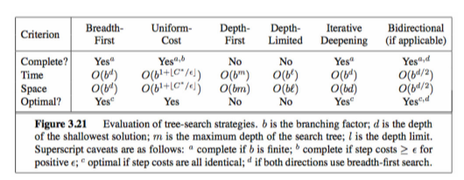
Comparing uninformed search strategies

Slide 22
REFERENCES
Artificial Intelligence: A Modern Approach by Stuart Russell and Peter Norvig. Prentice-Hall, 2003 (2nd Edition).

Slide 23
THANK YOU
For queries
Email: Ankur.e13693@cumail.in

